Slide 1
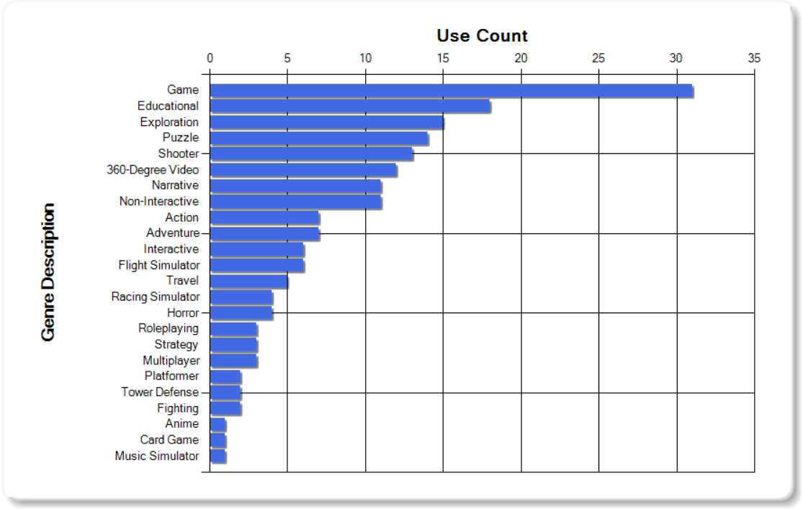
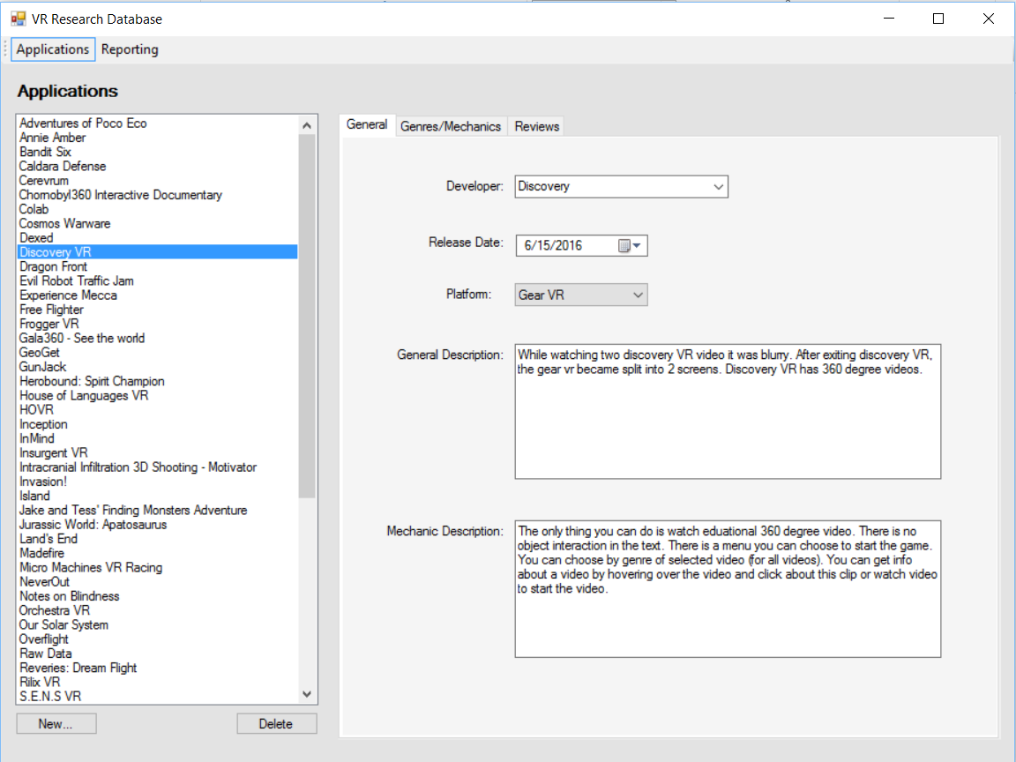
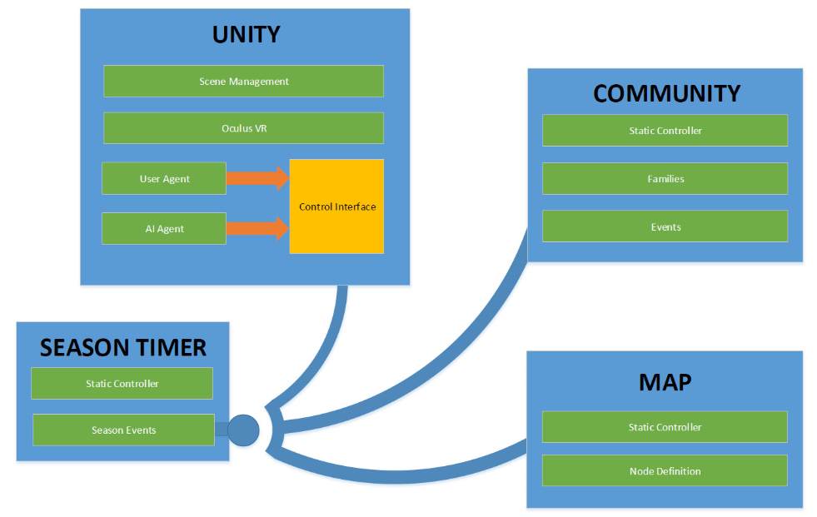

VR Application Research/Design
Students name, Department of Computer Science
Advisor, Sponsor
RESEARCH
Abstract
Method
Results
This is our problem statement – what we set out to solve and why it’s a meaningful project. “we planned out to create a VR application/game with the best experience.”
To analyze and visualize metrics of existing VR applications, we reviewed and collected data into a simple relational database. A simple application was then developed to store the results of our research, and provide reporting/graphing features.
Our research and analysis of VR genres and mechanics yielded various results:
Vision
Overview of what we planned to do. The idea that we wanted to make a VR experience, but did not know what hardware/software to use, what VR mechanics worked, etc.
Our initial plan – how we wanted to go about solving the problem. Initial design considerations, risk assessment, other parties involved (stakeholders), etc.
The above graph shows use of common genres in VR applications. Other data can relates these to mechanics.
The results of research were used to design a unique VR experience in the second half of the course.
Windows Forms Application with SQL Server LocalDB.
System Design
Discussion
Conclusion / Future works
DESIGN
The application architecture follows a simple modular design, separating functionality between the Unity engine and game logic.
Virtual Reality provides a dreamy experience for developers; finally presented, the medium of our dreams has seen the old school adaptations. Now we deal with cutting edge A.I. and the most efficient algorithms again similar to the original boom of 8-16 bit gaming. Our progress resides old ground, and leads to rediscovering storytelling in expansive and creative ways. The story of our simulation presents a simple world that will in surreal and abstract ways force you to question what it is you think you know. Absent and ignored histories of Native Peoples are a continuing aspect of humanities' struggle to survive in light of unending.
Oculus supports all commercial VR platforms with its robust features. Our project offers modified experiences based on the platform which are easily built for thanks to both Unity and Oculus. Designing the scenarios and simulation required a broad and adaptable feature set, which determines elements of play we can include. The performance issues were most directly affected by graphical rather than procedural considerations, while actual gameplay was limited by creative development of worthy GUI structures. Perhaps the greatest common element of games' themes are their interfaces.

